Slide 1
Track and Control System (TACS)
Robert Moss
Aaron Periera
Matthew Shrago

Slide 2
Tracking Module
Object Tracker
Detects objects by their:
RGB values (Red, Green, Blue)
HSV values (Hue, Saturation, Value)
Facial Detection Tracker
Uses the OpenCV FacialRecognizer class.
Mouse Tracker
Uses the Windows API to get the mouse position.

Slide 3
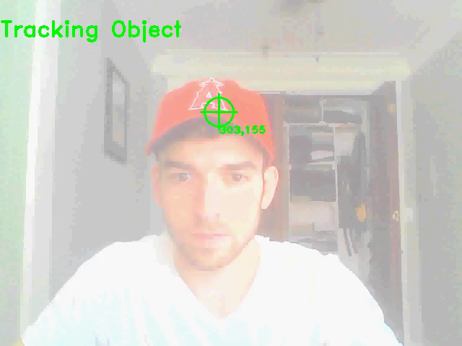
Object Tracker Feature 1
Tracking by hue, saturation, and value of the video feed.

Slide 4
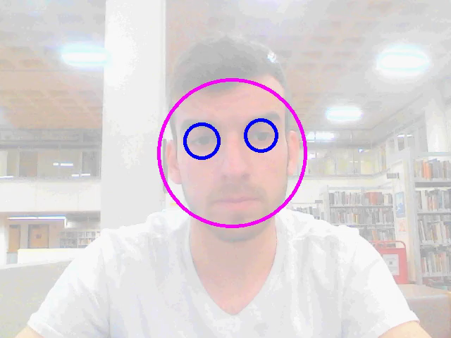
Facial Detection Tracker Feature 2
Using OpenCV’s built in FacialRecognizer class

Slide 5

Mouse Tracker Feature 3
An alternative to using the camera
For users who feel uncomfortable with their camera on, continuously.
Records the (x, y) position of the mouse and uses that as the “tracked object”.

Slide 6
Windows Control Module
Windows Grid Organizer
Organizes 5 windows into a grid like structure
Windows Perspective
Fans out windows in an ascending Z-order
Sleep Manager
Puts computer to sleep (after delay) once the user is away from the tracker.
Top
Left
Middle
Right
Bottom

Slide 7
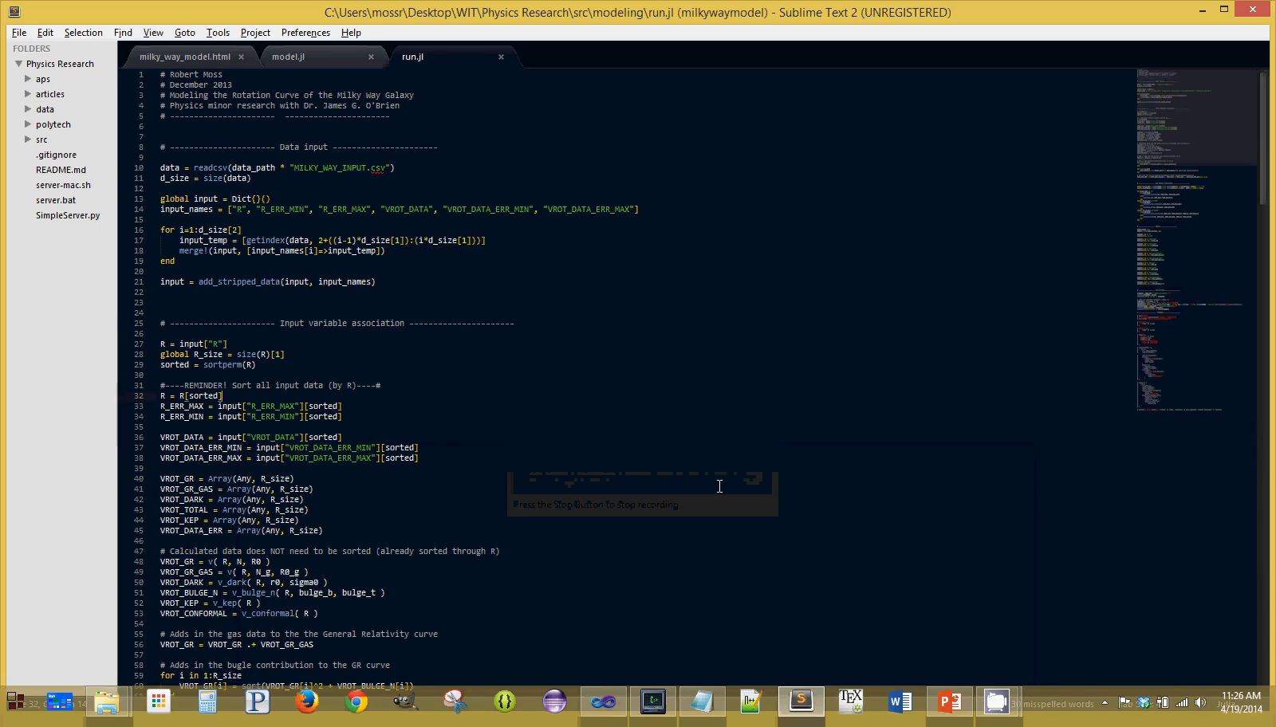
Windows Grid Organizer Feature 4

Slide 8
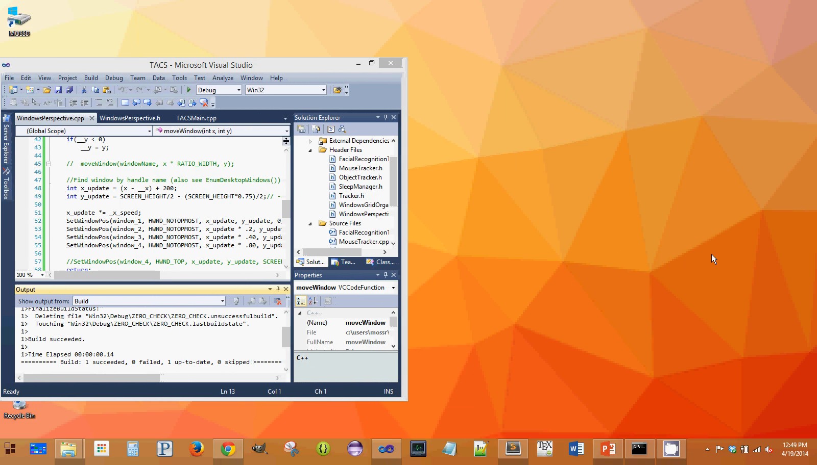
Windows Perspective Feature 5

Slide 9
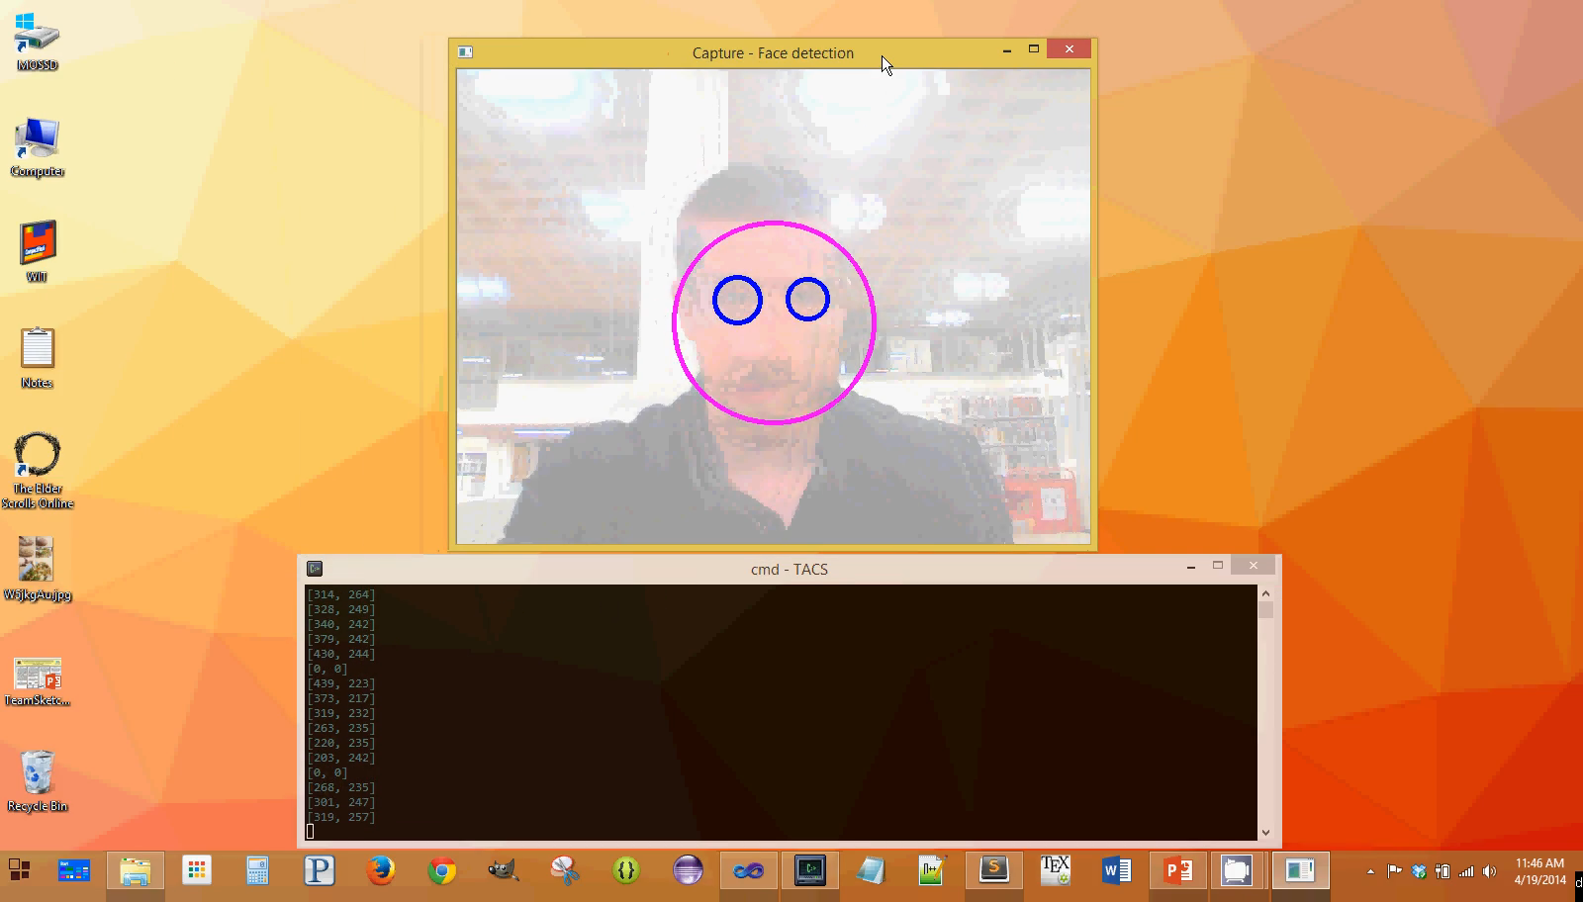
Sleep Manager Feature 6

Slide 10
GUI Feature 7 (QT)

Slide 11
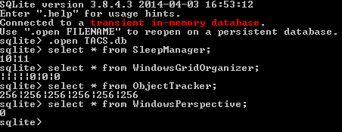
Database Feature 8 (SQLite)
name | type | size
 | ObjectTracker
red | int | 8
green | int | 8
blue | int | 8
hue | int | 8
saturation | int | 8
value | int | 8
 | WindowsGridOrganizer
left | String | 32
right | String | 32
top | String | 32
bottom | String | 32
middle | String | 32
speed | float | 32
left_right_ratio | int | 8
top_bottom_ratio | int | 8
 | WindowsPerspective
speed | float | 32
 | SleepManager
delay | int | 32
hibernate | bool | --

Slide 12
Future Work
More windows features to help improve screen real estate (and battery life).
Extend on the facial detection algorithm:
Apply a Kalman filter to estimate the position of the object if out of view.

